Slide 1



Slide 2

A Bit of History…
1952 – Established as the only official MD33 Lions official statewide project
1952 – First Eye Research Grant for $5,000 given to Harvard Medical School;
instrumental in finding solution that eliminated baby blindness – today
over 150,000 adults can see as a result
1958 – Massachusetts Lions Eye Research Fund, Inc. was incorporated
1959 – MLERF given tax exempt status as 501 (C) (3)

Slide 3
History continued…
1999 – Presidential Grant with matching LCIF funds established
1999/2000 – First time Fund raised over $1 million in single year donations
MLERF has supported eye research continuously for 73 years
Fund has given out over $42 million in research grants over the years

Slide 4
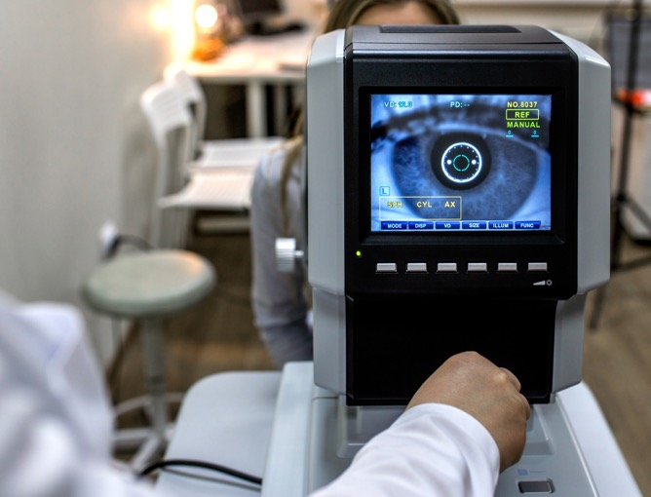
Donations by MD33 District - year ending 6/30/24
  District Y = $81,785
  District A = $101,667
  District N = $195,415
  District K = $205,059
  District S = $335,565
  TOTAL = $919,491

Slide 5
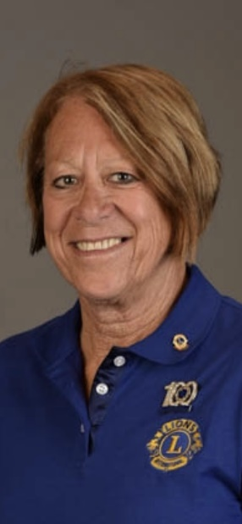
MLERF’s 58th President – 2024/2025
        Bev Dillon, PDG
        Bridgewater Lions Club

Slide 6
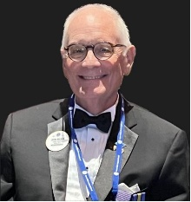
MLERF’s Immediate Past President
In Loving Memory Of
John Riemer, PCS 33A

Slide 7
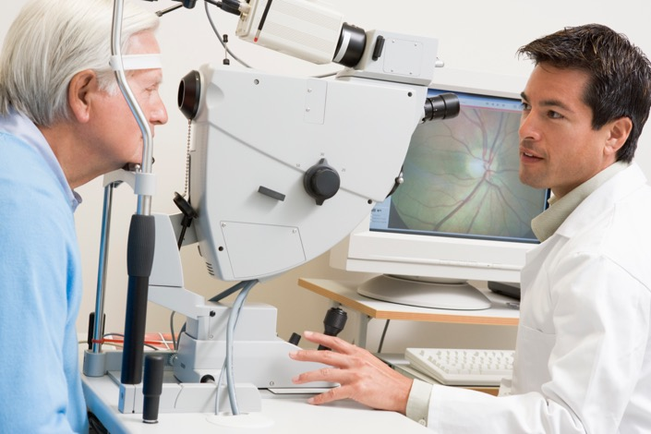
All time donations by MD33 District - through 6/30/24
  District Y = $3,734,508
  District A = $4,167,449
  District N = $11,023,528
  District K = $8,873,011
  District S = $11,486,245
  TOTAL = $39,284,741

Slide 8
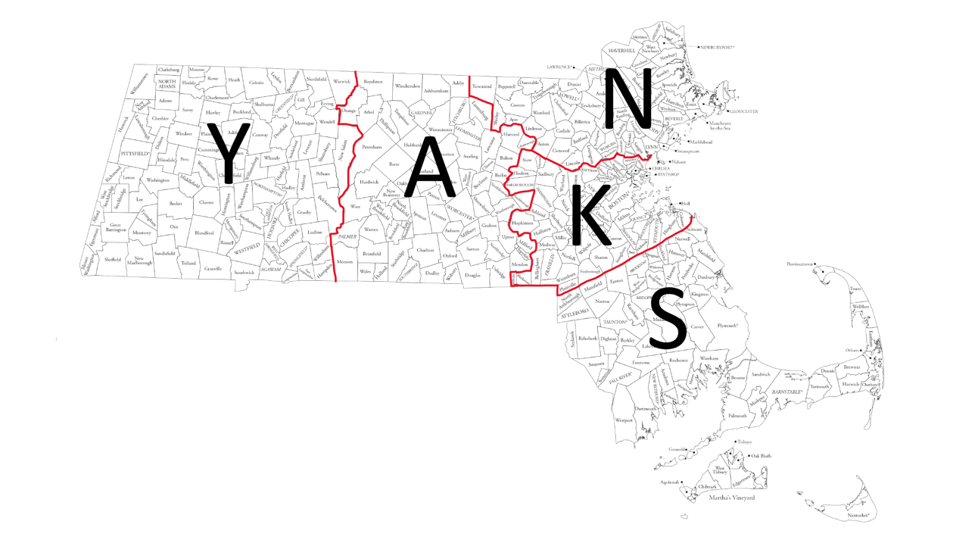
Massachusetts Lions
MD33 - Y, A, N, K, S

Slide 9
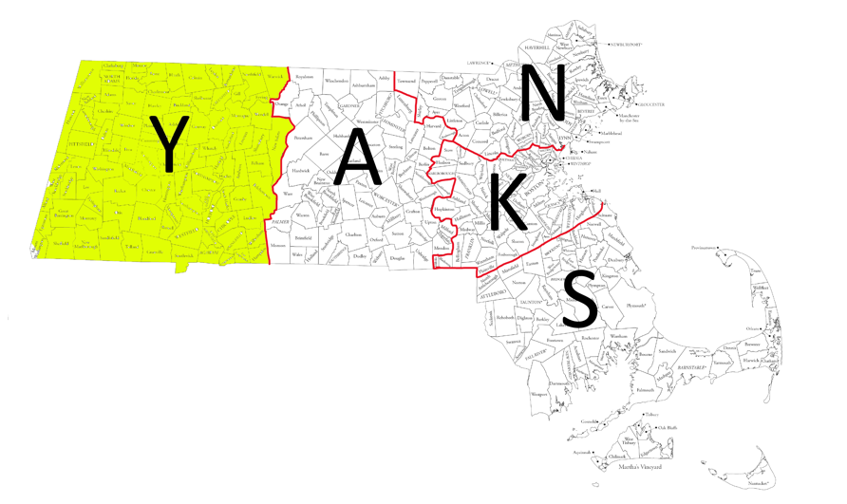
District Y
All time donations = $3,734,508
                Key Lions contact for all matters related to MLERF
                Jean Wilder, PCC
                MLERF – Past President
                jwmartinhl@yahoo.com
                Mobile phone – 413-774-5925

Slide 10
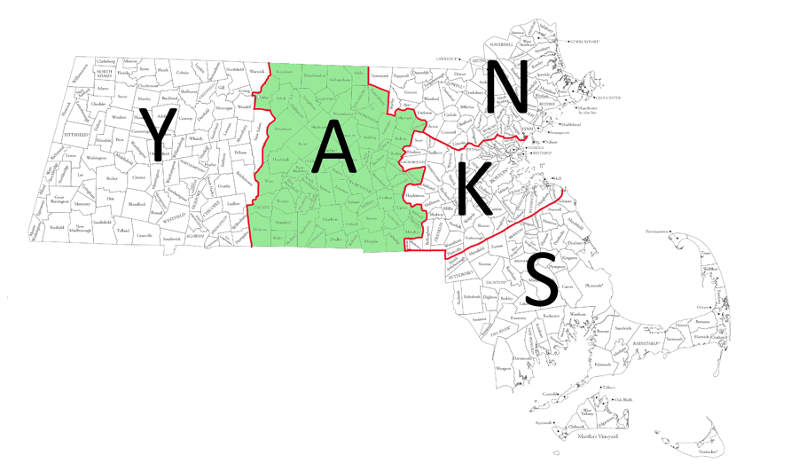
District A
                All time donations = $4,167,449
                Key Lions contact for all matters related to MLERF
Robert Grover, PRC 33A
MLERF Secretary
groverr@comcast.net
cell – 508-473-5873

Slide 11
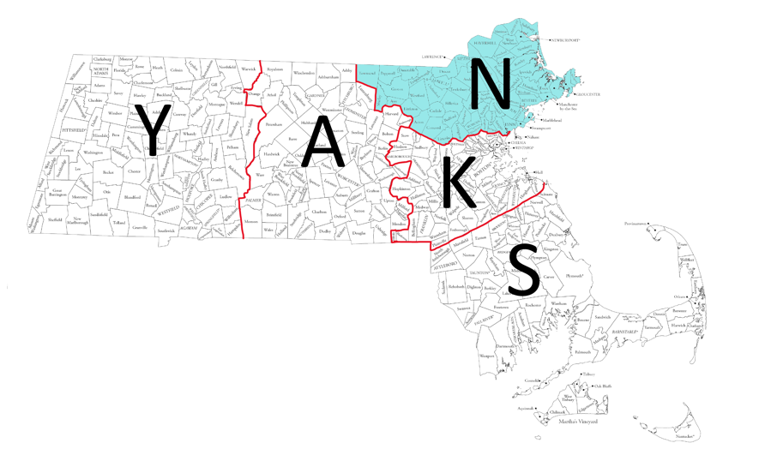
District N
                All time donations = $11,023,528
                Key Lions contact for all matters related to MLERF
                Brenda MacPherson, PRC 33N
                MLERF 2nd Vice President
                brendamacpherson2@gmail.com
                Mobile phone –978-532-4712

Slide 12
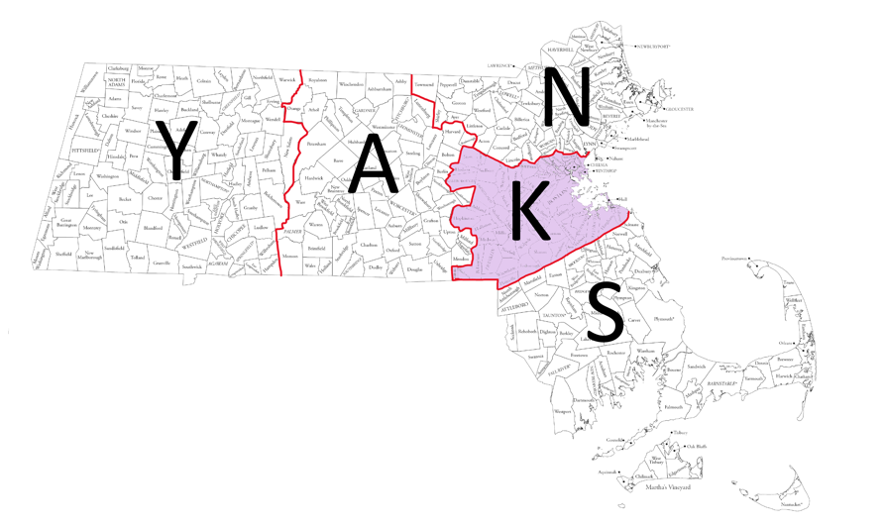
District K
                All time donations = $8,873,011
                Key Lions contact for all matters related to MLERF
                Patricia Kalicki, PDG 33K
                MLERF - 1st Vice President
                pak331@aol.com
                Mobile phone – 508-498-2770

Slide 13
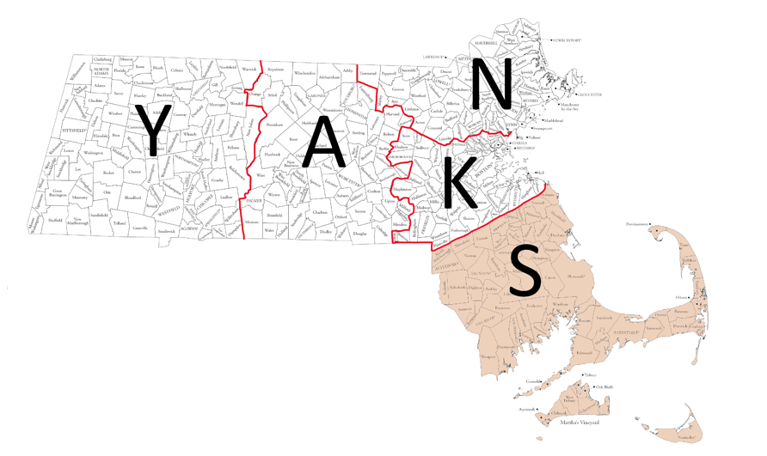
District S
                All time donations = $11,486,245
                Key Lions contact for all matters related to MLERF
                Beverly Dillon, PDG 33S
                MLERF President
                bevdillon497@gmail.com
                Cell Phone – 508-208-9349

Slide 14
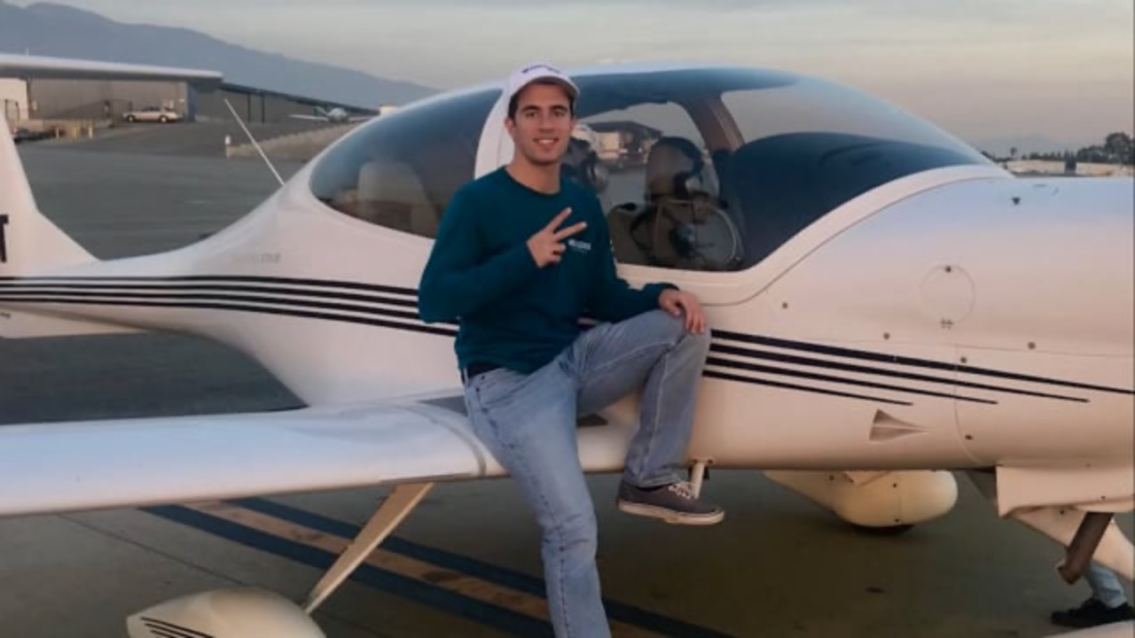

Slide 15
Approved Grants to Institutions Year Ending 6/30/24

Slide 16
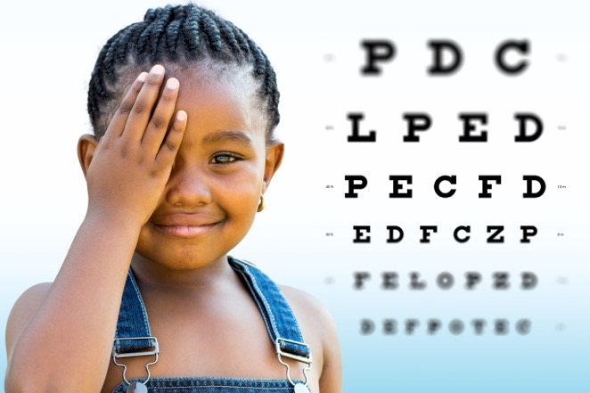
  Schepens Eye Research = $130,000
  Boston University = $130,000
  Massachusetts Eye & Ear = $130,000
  Joslin Diabetes = $130,000
  Children’s Hospital = $130,000
  Tufts University = $130,000
  Presidential Grant = $200,000
  TOTAL = $980,000

Slide 17
All time Grants to Institutions

Slide 18
  Schepens Eye Research = $7,748534
  Boston University = $7,791,490
  Massachusetts Eye & Ear = $7,599,014
  Joslin Diabetes = $6,737,204
  Tufts University = $4,140,175
  Children’s Hospital = $4,040,210
  Other (includes Presidential Grants) = $3,826,092
  TOTAL = $42,012,719

Slide 19
In Summary…
73 years of continuous support to the Eye Research Laboratories
of Massachusetts
Every penny donated since 1952 has been given back in research grants
Over $42 million given out in research grants since 1952
Massachusetts Lions Multiple District 33 – ‘Together We Serve’

