Slide 1


www.mlerfi.com

Slide 2

A Bit of History…
1952 – Established as the only official MD33 Lions official statewide project
1952 – First Eye Research Grant for $5,000 given to Harvard Medical School;
instrumental in finding solution that eliminated baby blindness – today
over 150,000 adults can see as a result
1958 – Massachusetts Lions Eye Research Fund, Inc. was incorporated
1959 – MLERF given tax exempt status as 501 (C) (3)

Slide 3
History continued…
1999 – Presidential Grant with matching LCIF funds established
1999/2000 – First time Fund raised over $1 million in single year donations
MLERF has supported eye research continuously for 75 years
Fund has given out over $43 million in research grants over the years

Slide 4
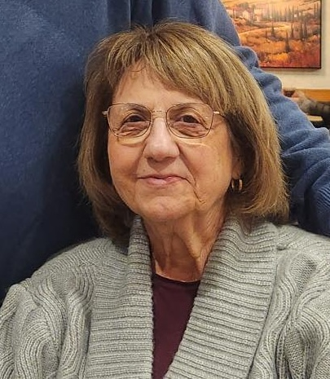
MLERF’s 59th President – 2025/2026
        Patricia Kalicki- PDG 33K
        Sherborn Lions Club

Slide 5
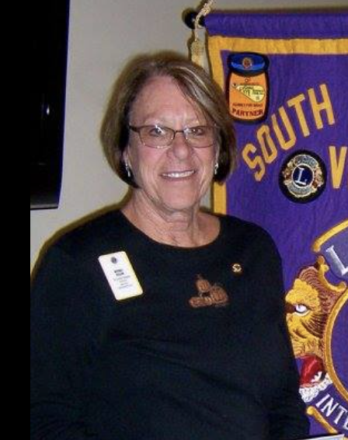
MLERF Immediate Past President - 2024/2025
        Beverly Dillon- PDG 33S
        Bridgewater Lions Club

Slide 6
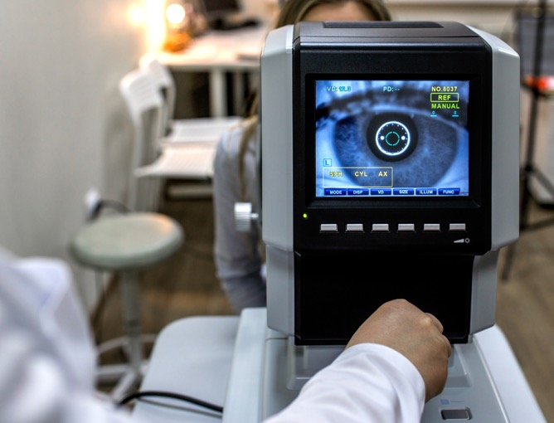
Donations by MD33 District - year ending 6/30/25
  District Y = $60,890
  District A = $83,241
  District N = $213,597
  District K = $213,773
  District S = $378,130
  TOTAL = $1,149,621

Slide 7
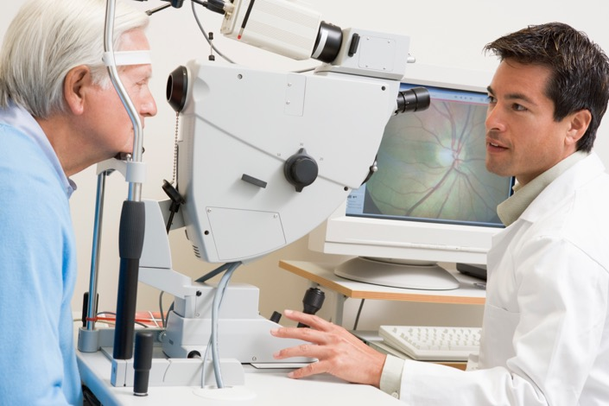
All time donations by MD33 District - through 6/30/25
  District Y = $3,502,886
  District A = $3,902,295
  District N = $10,430,943
  District K = $8,017,456
  District S = $10,551,556
  TOTAL = $36,405,118

Slide 8
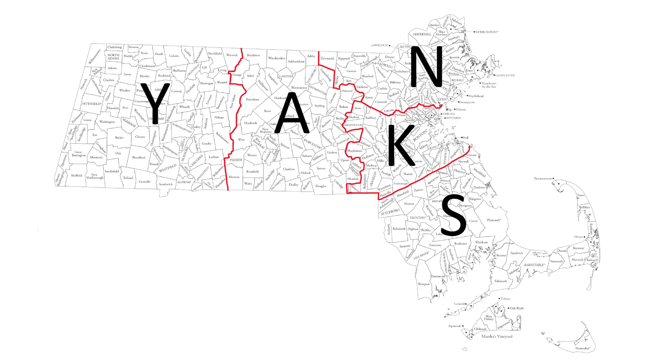
Massachusetts Lions
MD33 - Y, A, N, K, S

Slide 9
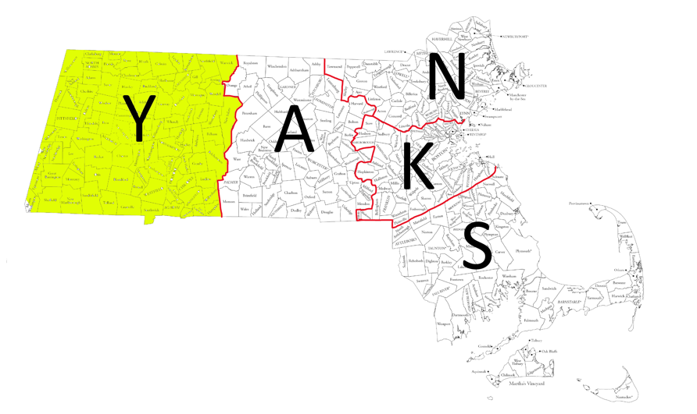
District Y
                All time donations = $3,795,398
                Key Lions contact for all matters related to MLERF
Maryann Bankman
413-535-8533 (C)
mtmnovajo@aol.com

Slide 10
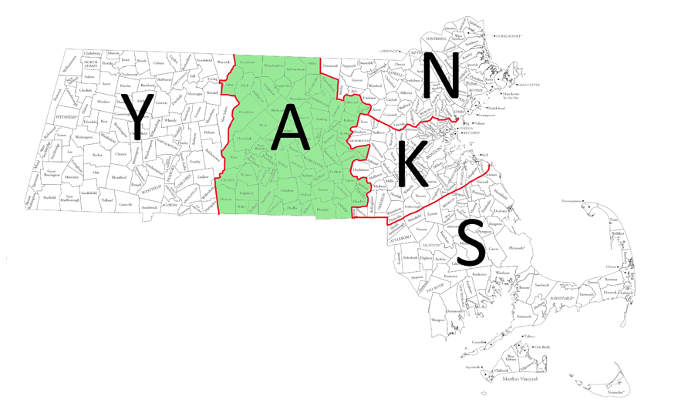
District A
                All time donations = $4,250,690
                Key Lions contact for all matters related to MLERF
                Robert Grover, PRC
                MLERF 2nd Vice President
                2vp@mlerfi.org
                Mobile phone – 508-857-8864

Slide 11
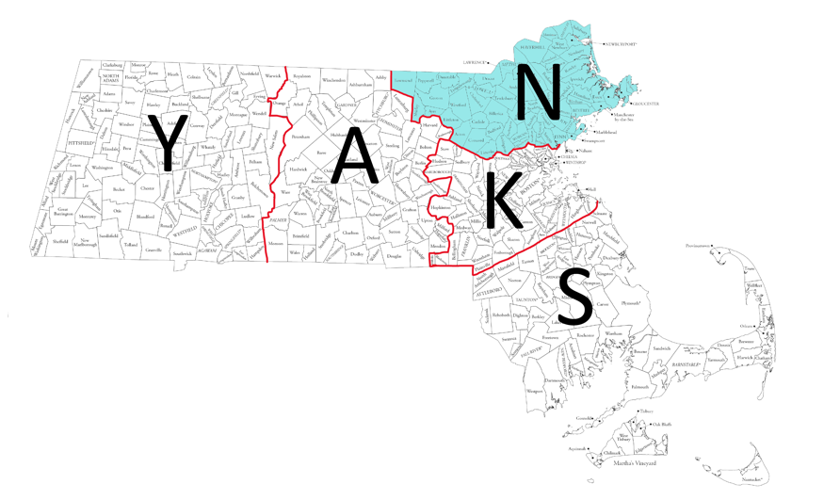
District N
                All time donations = $11,237,115
                Key Lions contact for all matters related to MLERF
                Brenda MacPherson, PRC
                MLERF 1st Vice President
                1vp@mlerfi.org
                Mobile phone – 617-834-7172

Slide 12
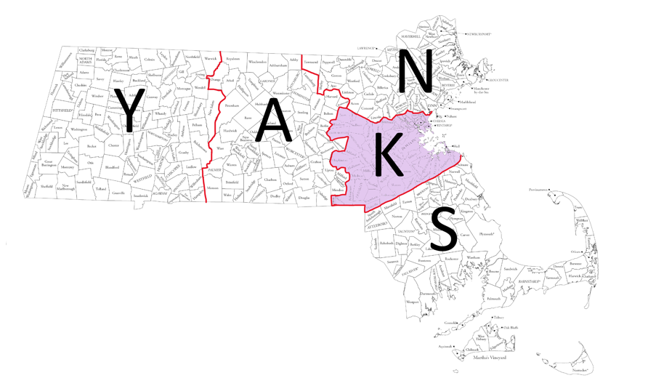
District K
                All time donations = $9,086,798
                Key Lions contact for all matters related to MLERF
                Patricia Kalicki, PDG 33K
                MLERF President
                president@mlerfi.org
                Mobile phone – 508-498-2770

Slide 13
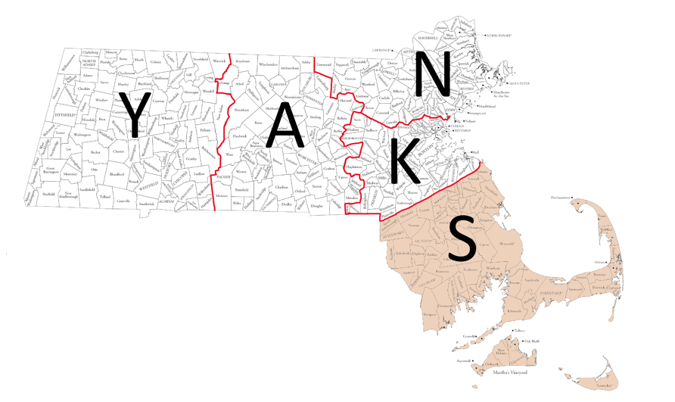
District S
                All time donations = $11,864,375
                Key Lions contact for all matters related to MLERF
                Kathryn Salem, PDG 33S
                MLERF Secretary
                secretary@mlerfi.org
                Cell phone – 781-308-2881

Slide 14
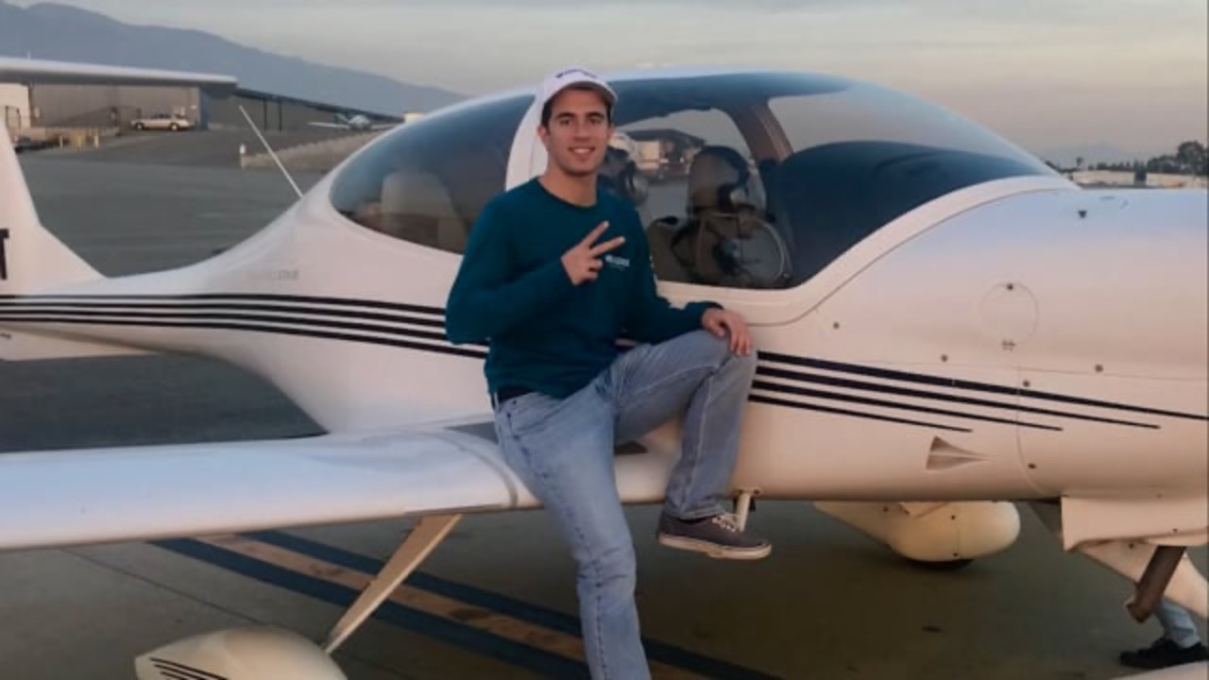

Slide 15
Grants to institutions - year ending 6/30/25
www.mlerfi.com

Slide 16
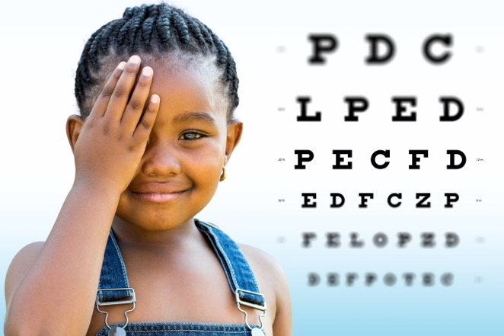
Boston Children’s Hospital – $138,000
BU School of Medicine – $138,000
Joslin Diabetes Center – $138,000
Massachusetts Eye & Ear – $138,000
Schepens Eye Research Ctr. – $130,000
NE Eye Center/Tufts MC – $138,000
Presidential Grant
New England Eye Center/Tufts Medical Center
$200,000
  TOTAL = $920,000

Slide 17
All time Grants to institutions
www.mlerfi.com

Slide 18
Boston Children’s Hospital: $4,178,210
BU School of Medicine: $8,059,490
Joslin Diabetes Center: $6,875,204
Massachusetts Eye & Ear: $7,737,014
NE Eye Center/Tufts MC: $4,478,174
Schepens Eye Research Ctr.: $7,878,536
Other (Including Presidential): $3,826,092
  TOTAL = $43,032,718

Slide 19
In Summary…
75 years of continuous support to the Eye Research Laboratories
of Massachusetts
Every penny donated since 1952 has been given back in research grants
Over $43 million given out in research grants since 1952
Massachusetts Lions Multiple District 33 – ‘Together We Serve’

